Slide 1


Bachelor’s Degree in Aerospace Vehicle Engineering
Design of an Unmanned Aerial Vehicle with a Mass-Actuated Control System
questions
why?
conclusions
results
flight mechanics
propulsion
management
avionics
definition
structures
scope
aerodynamics
Bachelor of Science Thesis
Student: Armen Baghdasaryan
Director: Luis Manuel Pérez Llera

Slide 2
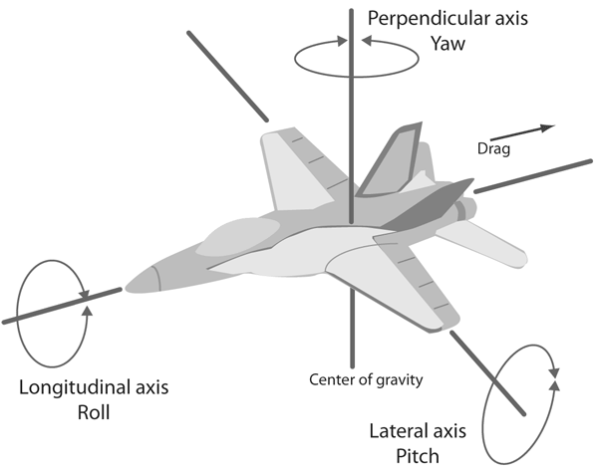
Auto
Design of an Unmanned Aerial Vehicle
with a
Mass-Actuated Control System
Autonomous System
Pre-defined path
Remote control
questions
why?
conclusions
results
flight mechanics
propulsion
management
avionics
scope
definition
structures
aerodynamics
Flight control surfaces vs.
Movable mass system

Slide 3
Auto
Justification
UAV
Important field of investigation
Multi-purpose and versatile
Market growth
questions
why?
conclusions
results
flight mechanics
propulsion
management
avionics
scope
definition
structures
aerodynamics
Conventional system drawbacks
Maintenance
Structural integrity
Cost
Performance

Slide 4
Auto
Scope
Aerodynamics
Airfoil selection
Wing plan-form design
Numerical simulations
Structures
Load diagrams
Cross section calculation
Numerical simulations
Avionics
Communication
Navigation
Power supply
Takeoff / Landing
Propulsion System
Required power
Propeller design
Motor selection
questions
why?
conclusions
results
flight mechanics
propulsion
management
avionics
definition
structures
scope
aerodynamics
Budget estimation
Market study
Cost and price estimation
Flight mechanics
Control system design
Algorithms implementation
Simulations

Slide 5
Auto
Management
List of tasks
+
Gantt diagram
Helps to keep the work:
Organized
Focused on specific tasks
questions
why?
conclusions
results
flight mechanics
propulsion
management
avionics
definition
structures
scope
aerodynamics
Influence on:
Projects success
Productivity

Slide 6
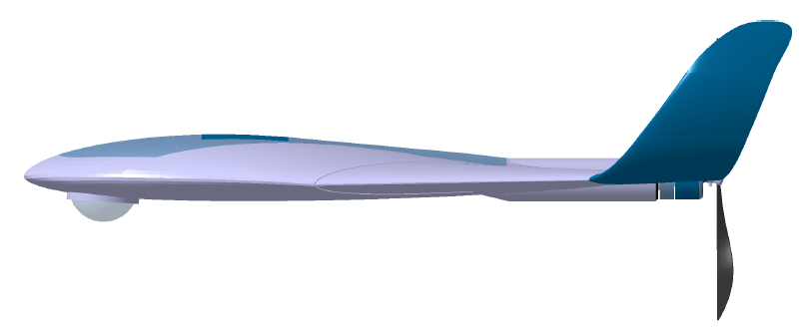
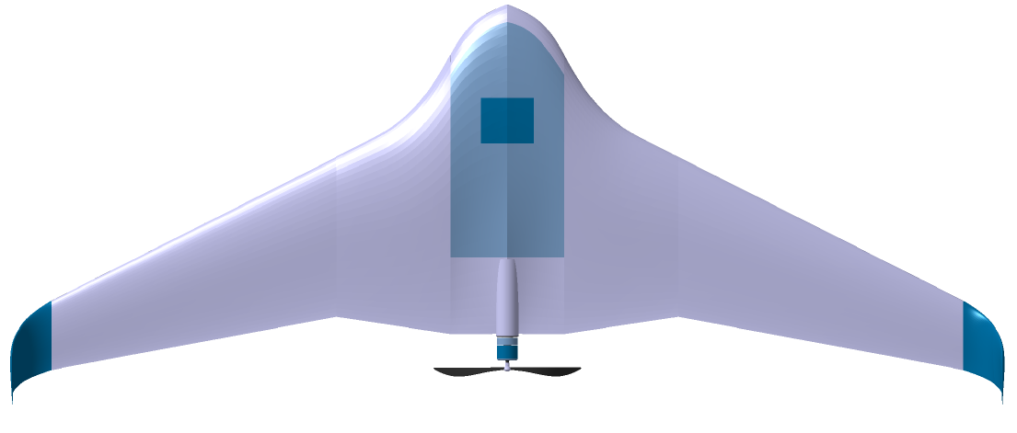
Auto
Aerodynamics
Flying wing configuration
S-shape airfoils
Eppler186
MH45
Frame design
Twist calculation: tip incident angle 0.64° higher
Wing swept: ≈ 25°
Blended wing-body design
questions
why?
conclusions
results
flight mechanics
propulsion
management
avionics
definition
structures
scope
aerodynamics

Slide 7
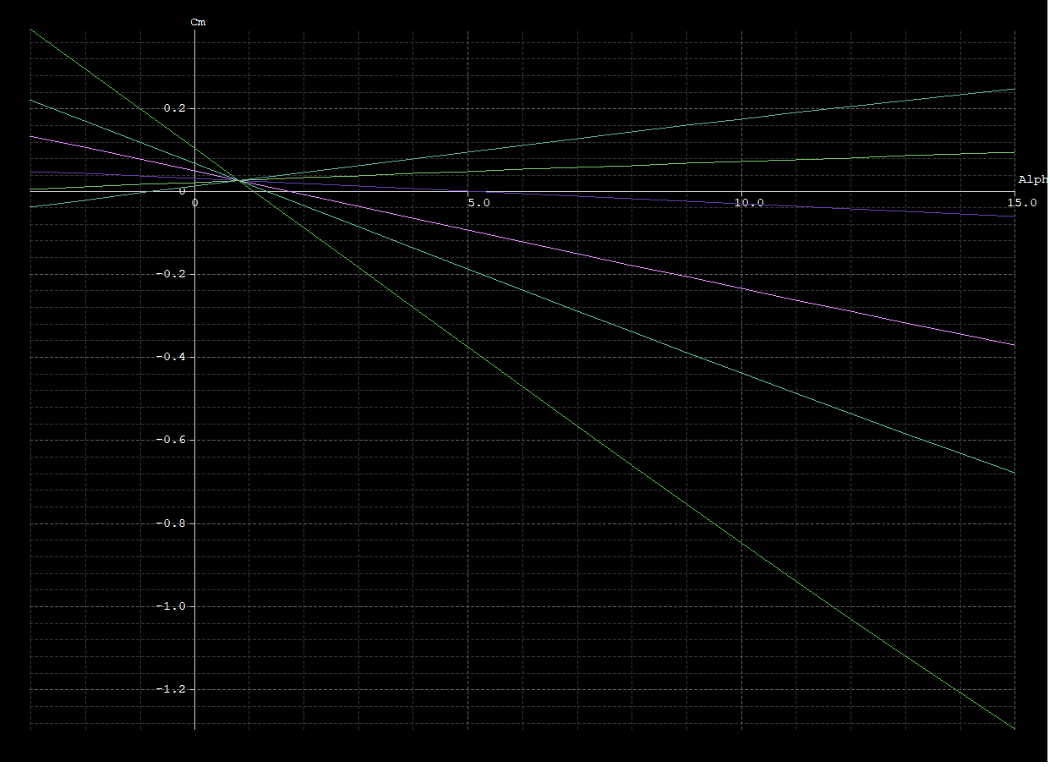
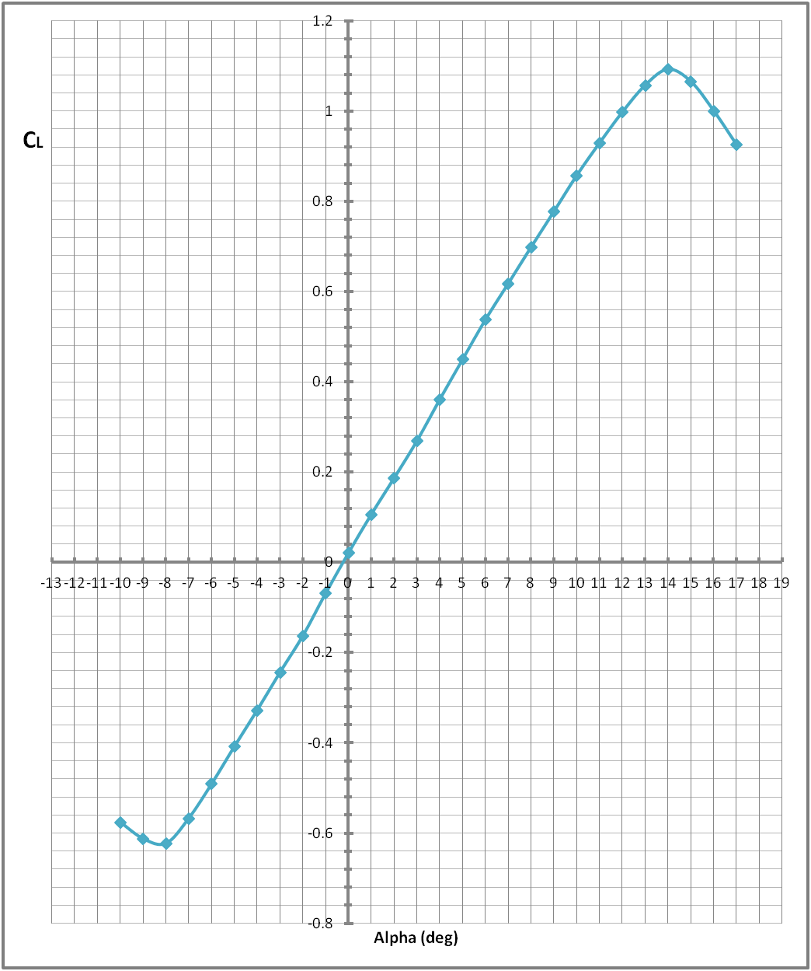
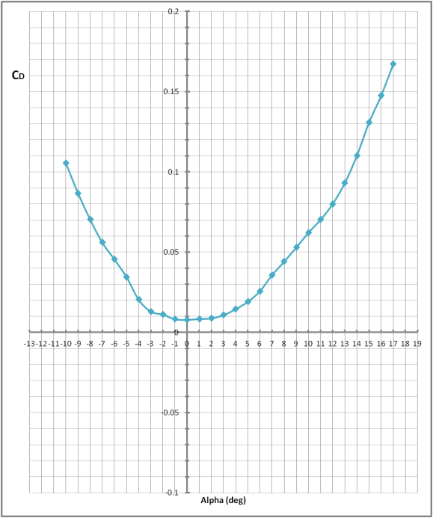
Auto
Aerodynamics
questions
why?
conclusions
results
flight mechanics
propulsion
management
avionics
definition
structures
scope
aerodynamics

Slide 8
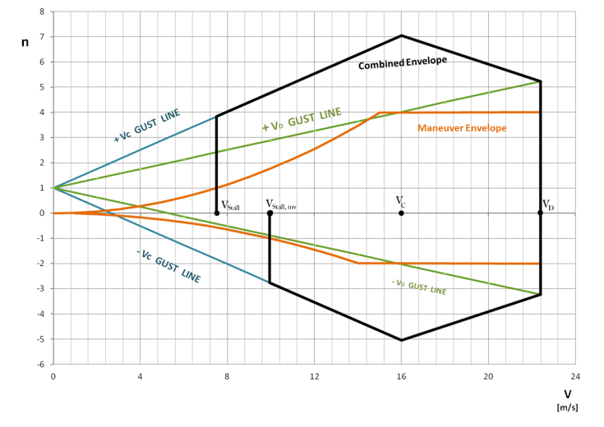
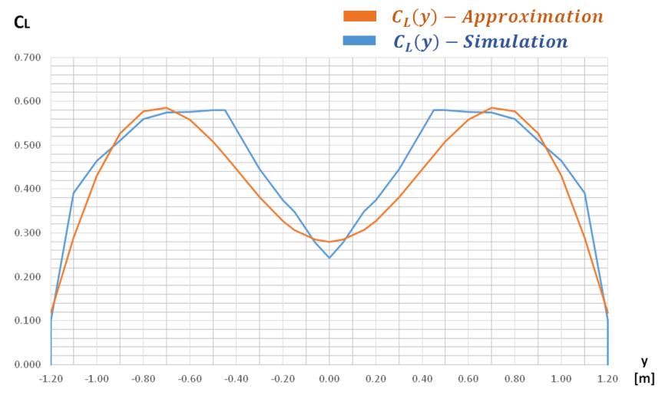
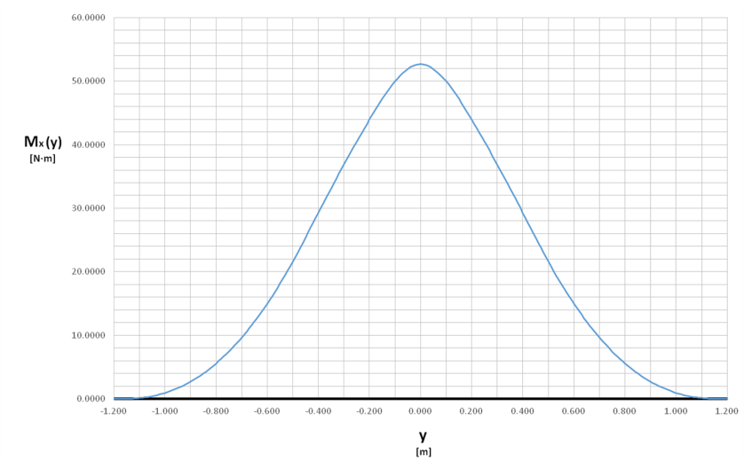
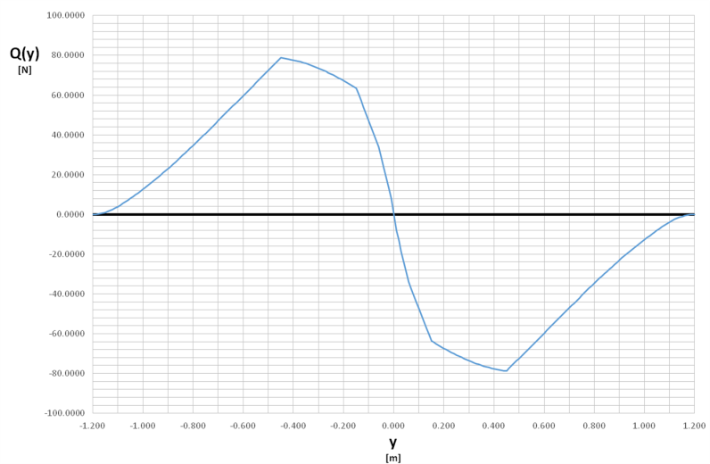
Auto
Structural design
questions
why?
conclusions
results
flight mechanics
propulsion
management
avionics
definition
structures
scope
aerodynamics

Slide 9
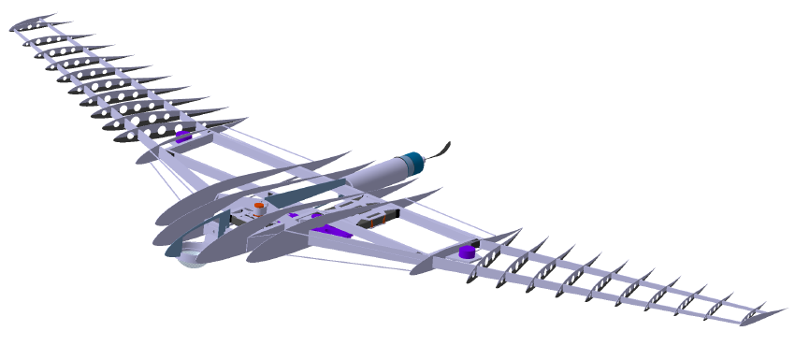
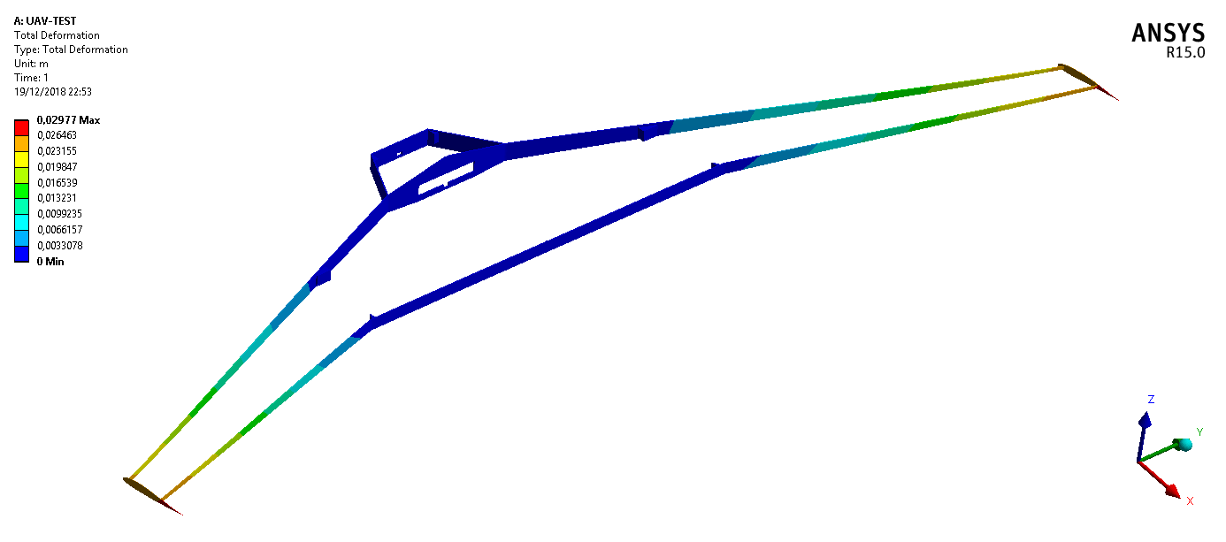
Auto
Structural design
questions
why?
conclusions
results
flight mechanics
propulsion
management
avionics
definition
structures
scope
aerodynamics
7.04 g
SF: 2
Max. deflection: 3mm

Slide 10
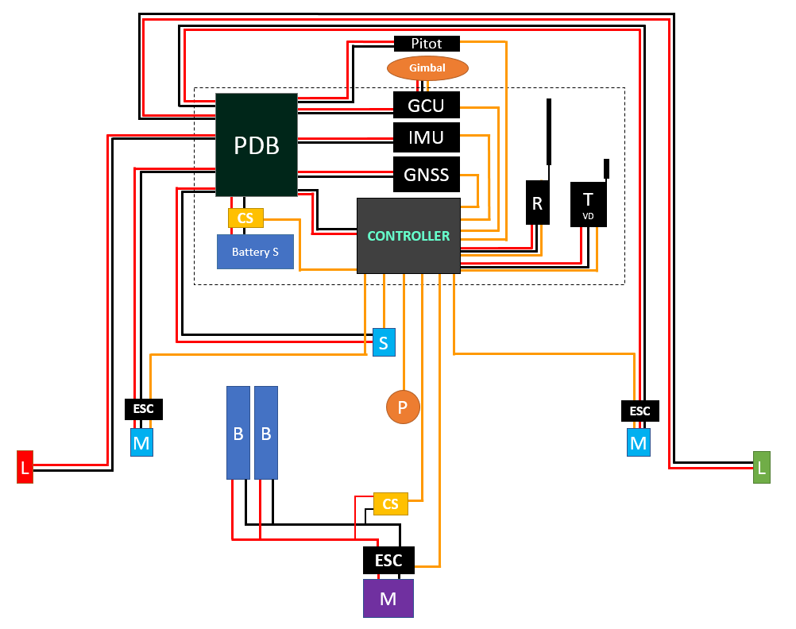
Auto
Avionics
questions
why?
conclusions
results
flight mechanics
propulsion
management
avionics
definition
structures
scope
aerodynamics

Slide 11
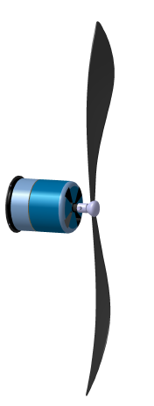
Auto
Propulsion
Required power calculation: Momentum Theorem
Takeoff: 32.8 W
Cruise: 475 W
Propeller efficiency at takeoff:
Momentum theorem: 0.54
Simplified BEM: 0.63
BEM with inflow factors: 0.48
Experimental data(APC): 0.44
questions
why?
conclusions
results
flight mechanics
propulsion
management
avionics
definition
structures
scope
aerodynamics
Endurance: 60 min

Slide 12
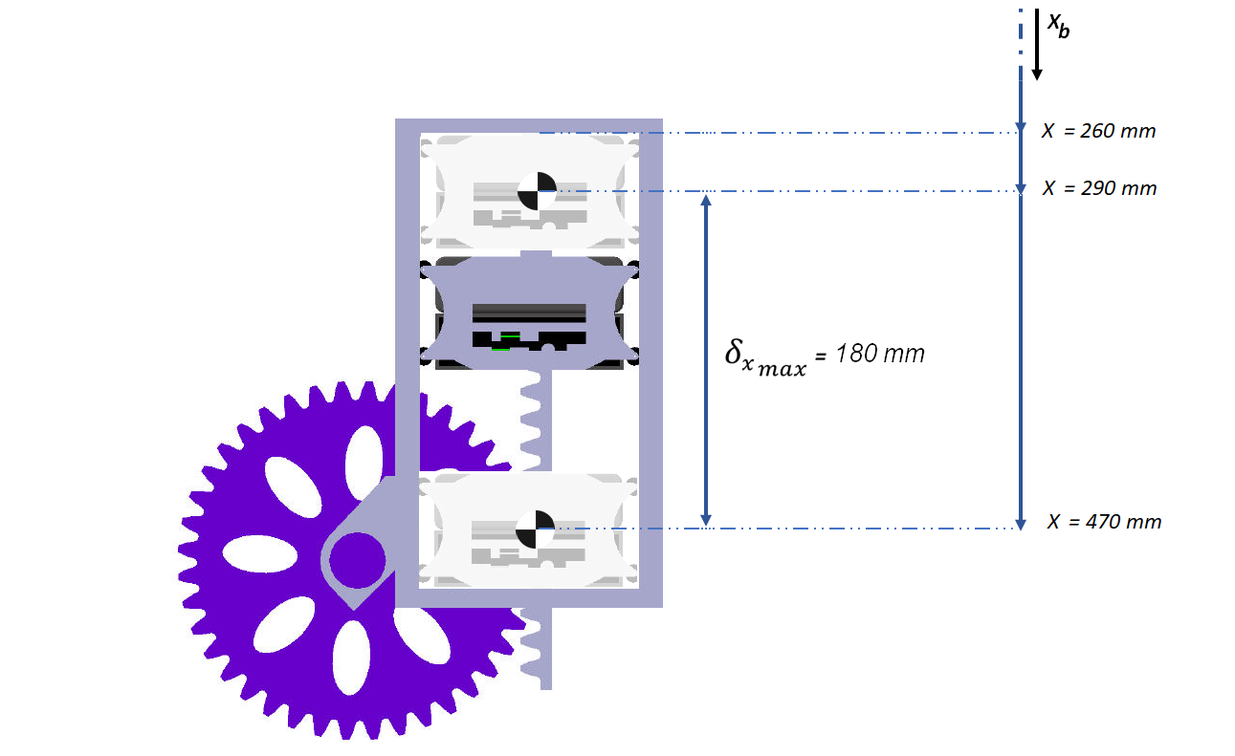
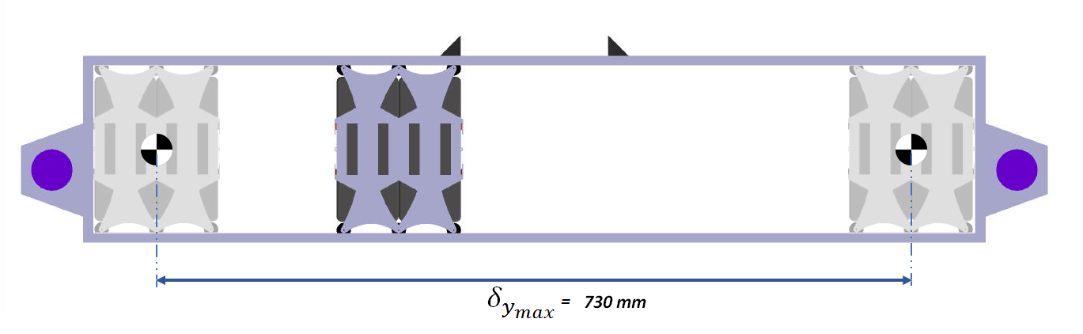
Auto
Control System Design
Analytical functions
Center of gravity
Inertia
Control derivatives
questions
why?
conclusions
results
flight mechanics
propulsion
management
avionics
definition
structures
scope
aerodynamics

Slide 13
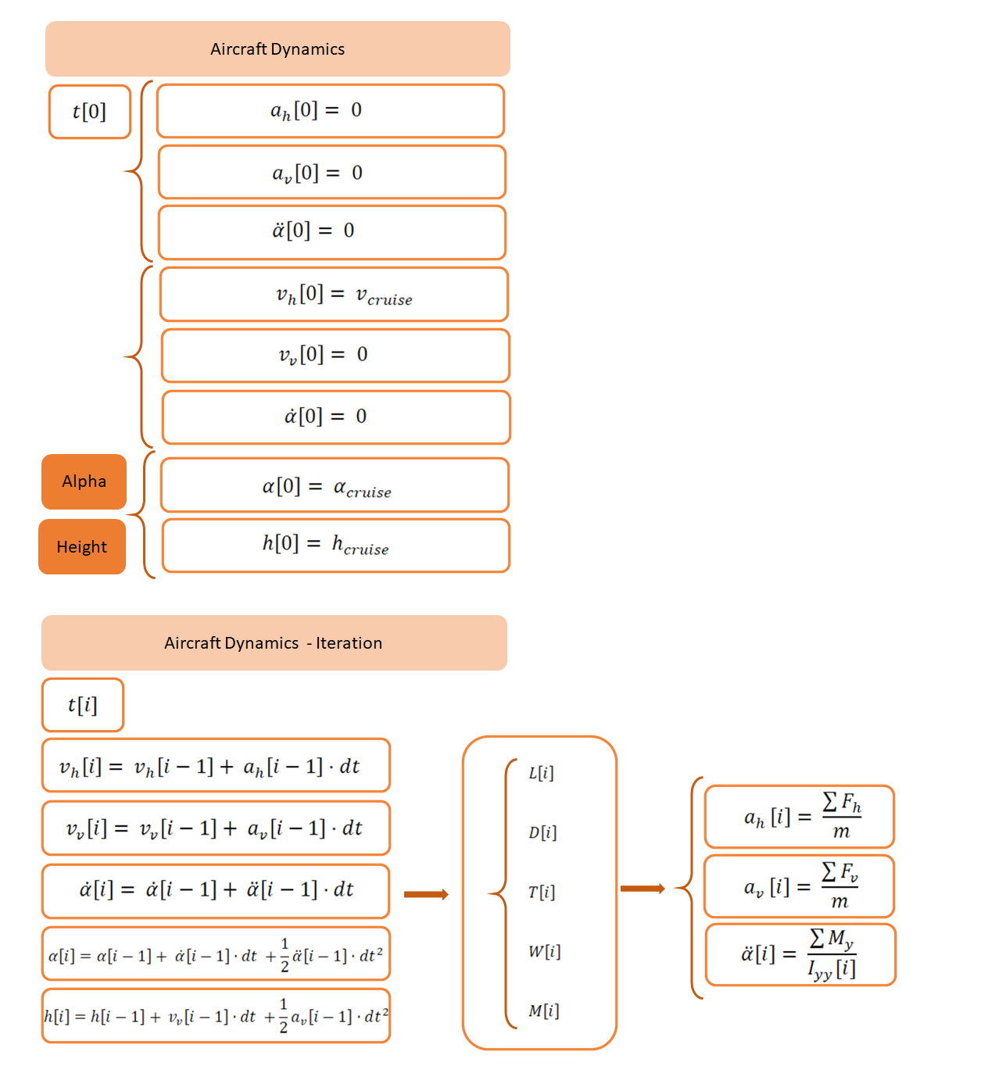
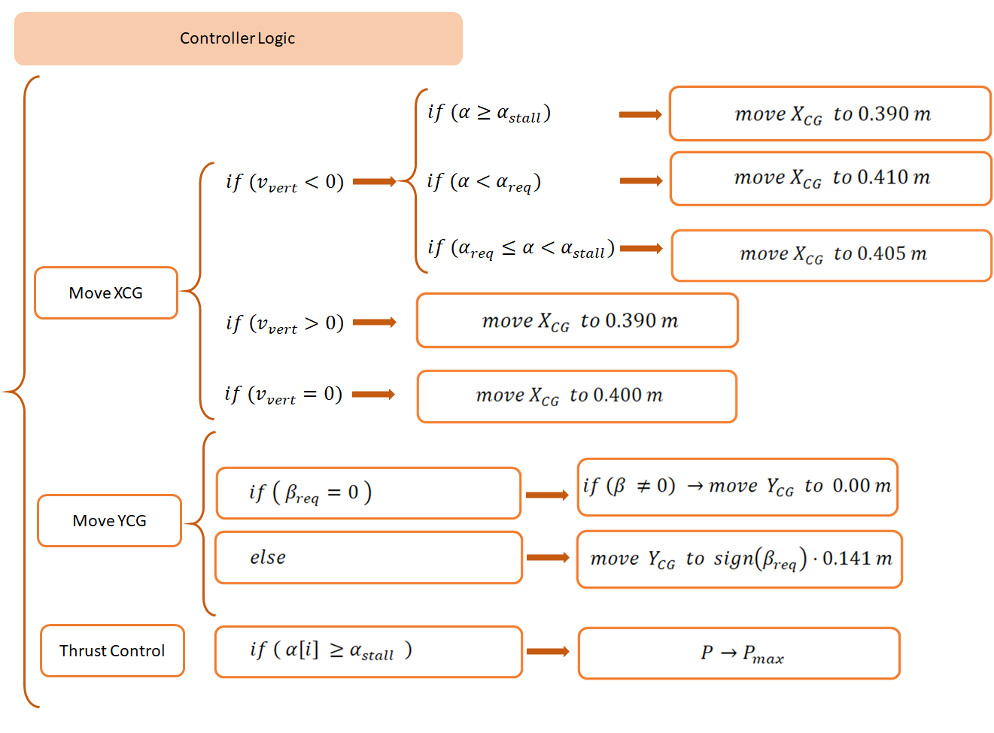
Auto
Flight control algorithms
questions
why?
conclusions
results
propulsion
management
avionics
definition
structures
scope
aerodynamics

Slide 14
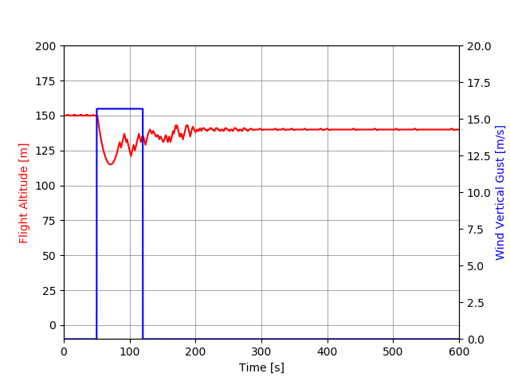
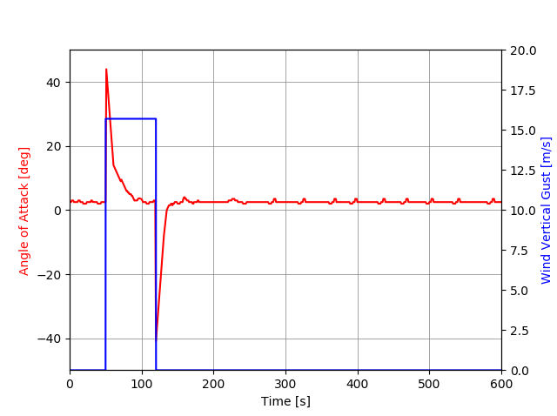

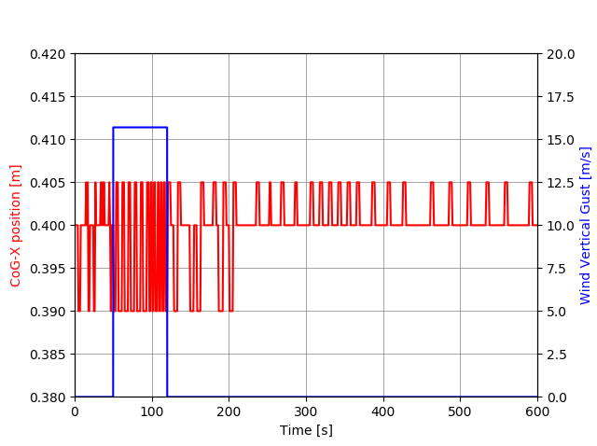
Auto
Flight control test
Simulations with a vertical gust of 6m/s and 15.74 m/s
questions
why?
conclusions
results
propulsion
management
avionics
definition
structures
scope
aerodynamics

Slide 15
Auto
Results
Simulations with a vertical gust of 6m/s and 15.74 m/s
Successful recovery even after stall
Expected behavior positioning of the movable mass
questions
why?
conclusions
results
flight mechanics
propulsion
management
avionics
definition
structures
scope
aerodynamics

Slide 16
Auto
Conclusions
Control system viability
Dependency on the aerodynamic design and airfoils
Straightforward mechanical design
Structural integrity
Stable / acceptable response against gusts
Competitive price
Fully electrical: less environmental impact
questions
conclusions
why?
results
flight mechanics
propulsion
management
avionics
definition
structures
scope
aerodynamics
Improvements and further development
Aerodynamic model
Simulink model (dynamics)
Simulations
Flight test

Slide 17
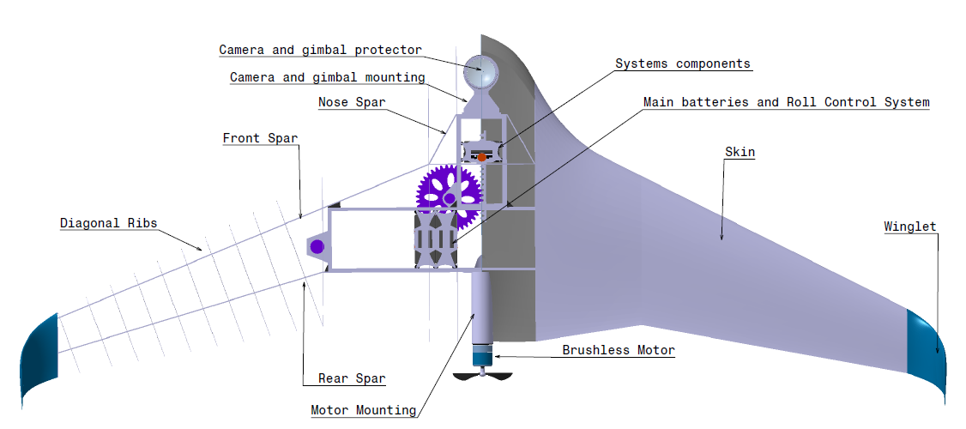
Auto
Questions
?
questions
why?
conclusions
results
flight mechanics
propulsion
management
avionics
definition
structures
scope
aerodynamics

